Slide 1

SCHOOL MANAGEMENT SYSTEM
A DESKTOP APPLICATION THAT WILL EASE YOUR WORK

Slide 2
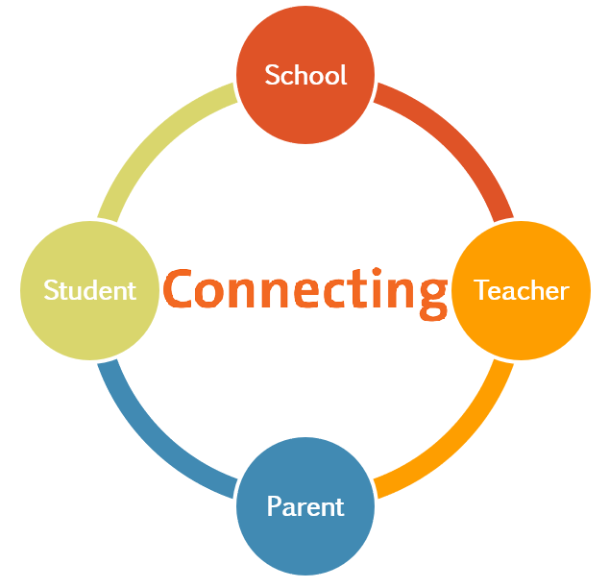
USERS
ADMIN
TEACHERS
STUDENTS
PARENTS

Slide 3
Start Page Login Signup

Slide 4
Login Signup

Slide 5
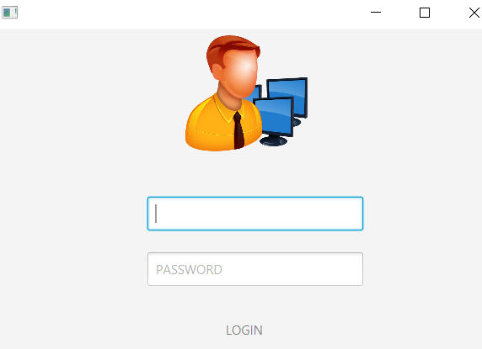
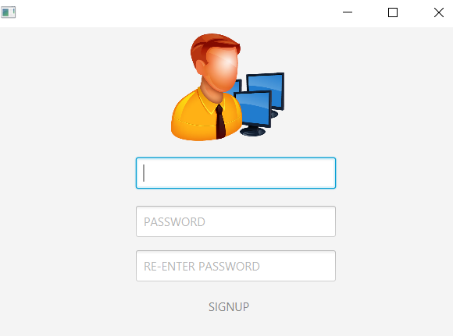
LOGIN SIGNUP

Slide 6
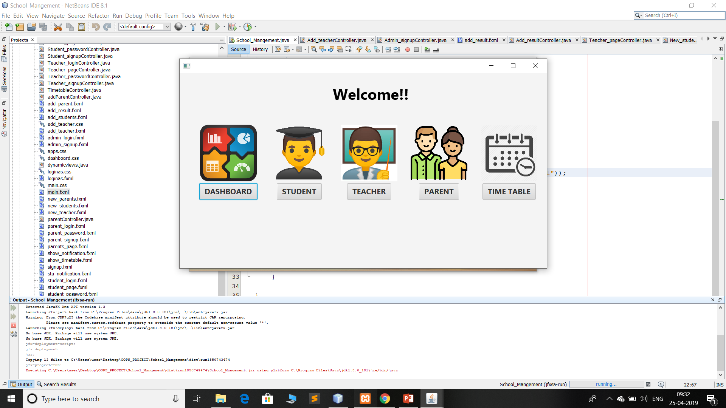
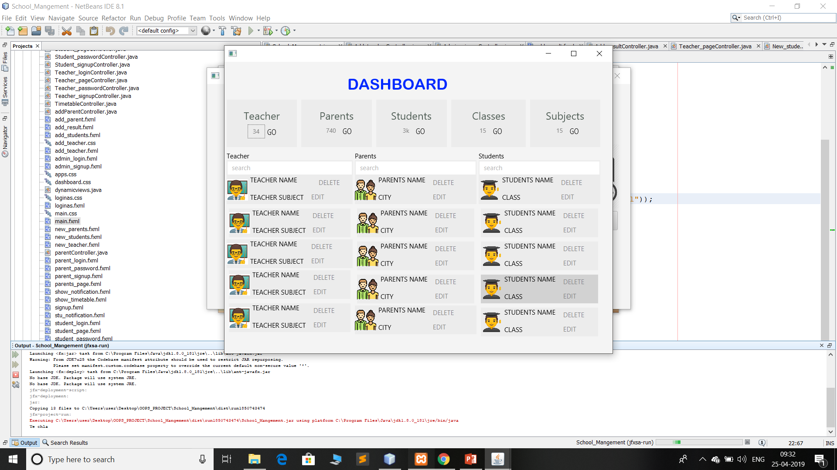
How to Proceed(Admin)
Dashboard
Showing the Statistics
1
Student
Search Student
Add Student
Update
2
Teacher
Search Teacher
Add Teacher
Update
3
Parents
Search Parents
Add Parents
Update
4
Timetable
It shows corresponding class timetable
5

Slide 7
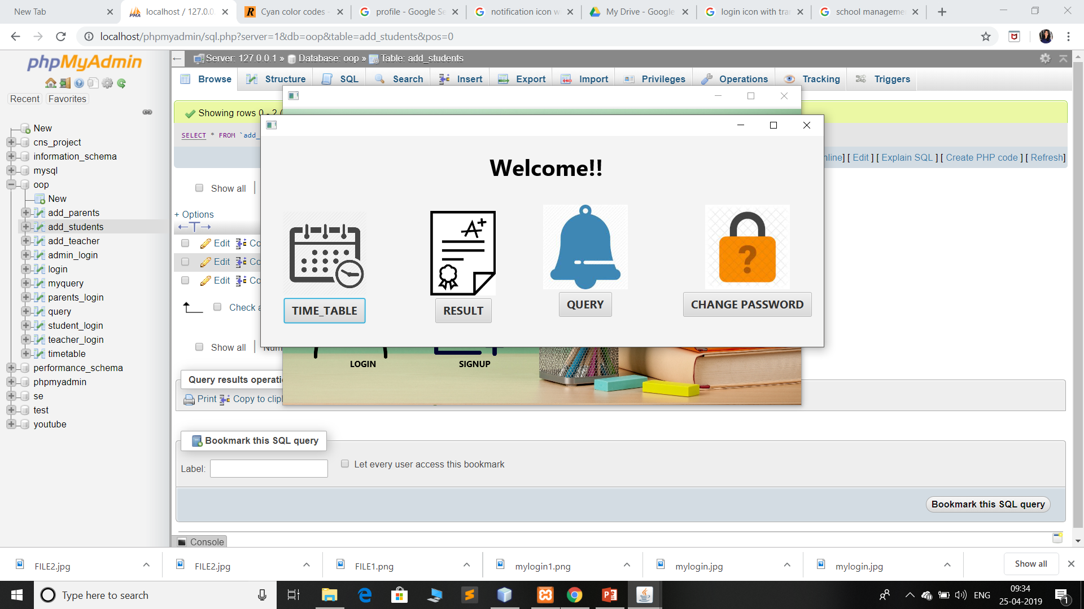
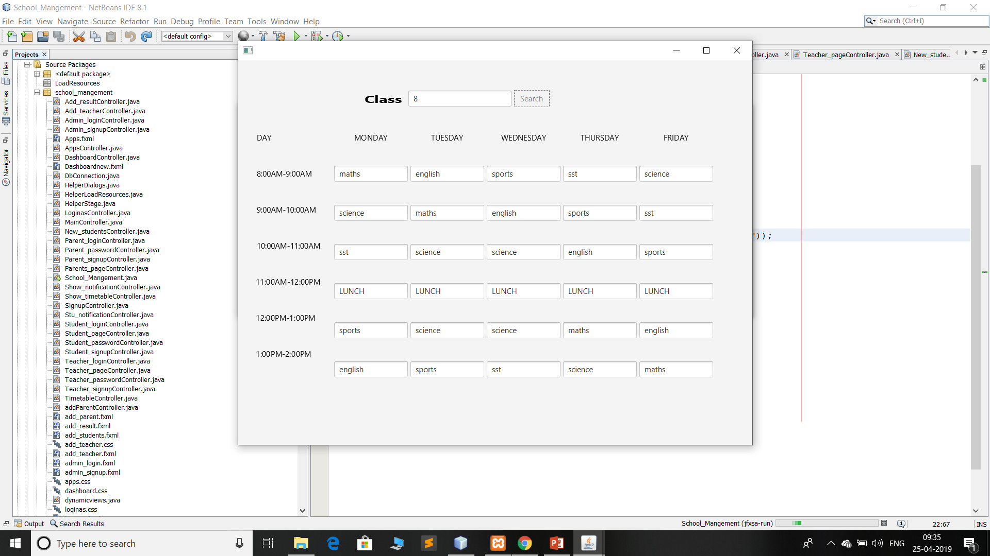
How to Proceed(Student)
Timetable
It shows corresponding class timetable
1
Result
Can see the Result
2
Query
Get the notification for related query
3
Change Password
4

Slide 8
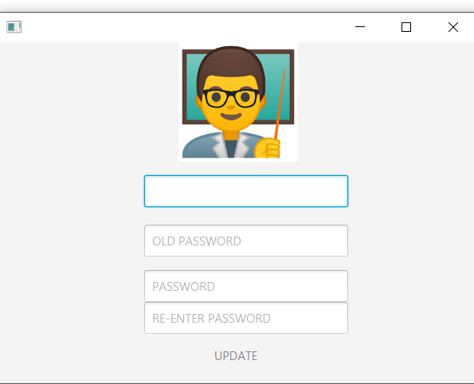
How to Proceed(Parent)
Timetable
It shows corresponding class timetable
1
Result
Can see the Result
2
Query
Get the notification for related query
3
Change Password
4

Slide 9
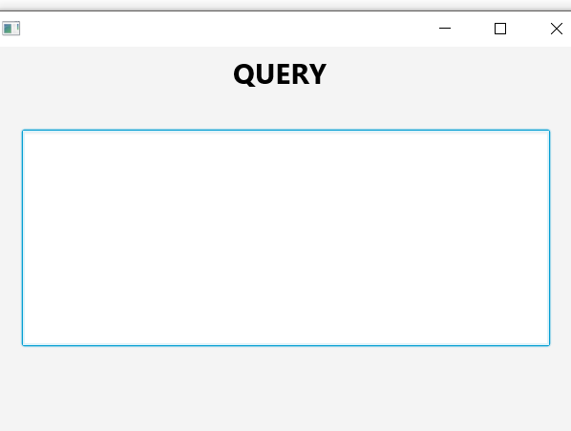
How to Proceed(Teacher)
Timetable
It shows corresponding class timetable
1
Result
Can update the result
2
Query
Post the query for students and parents
3
Change Password
4

Slide 10
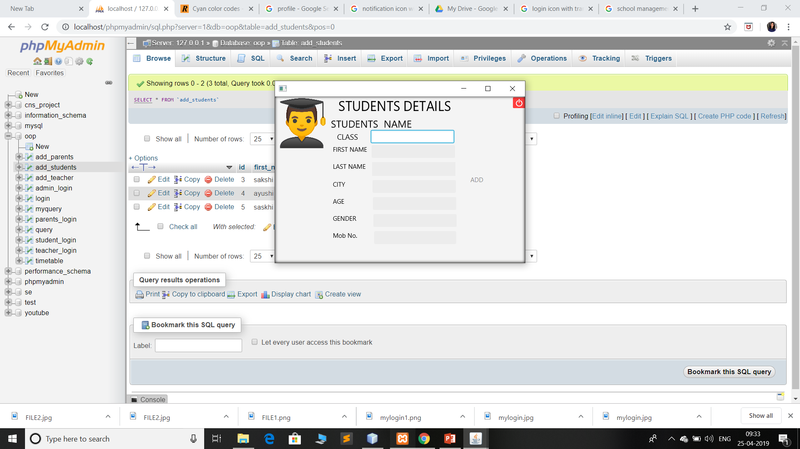
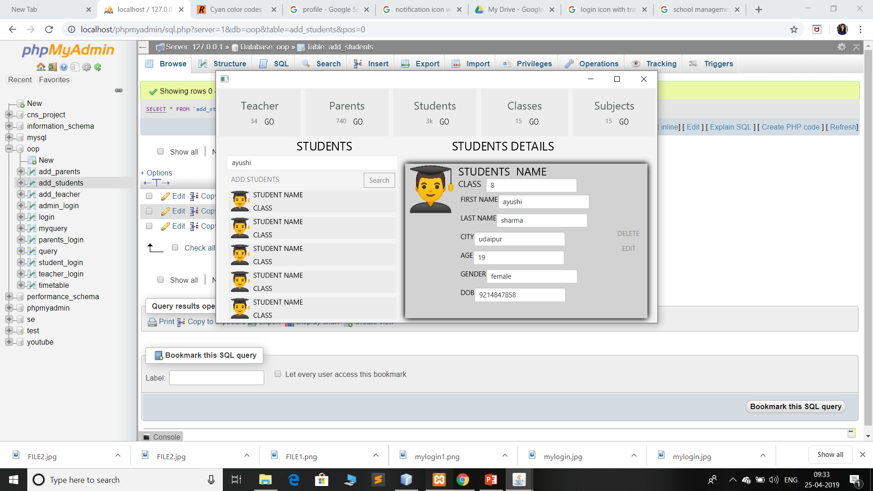
STUDENTS ADD
SEARCHING STUDENTS

Slide 11
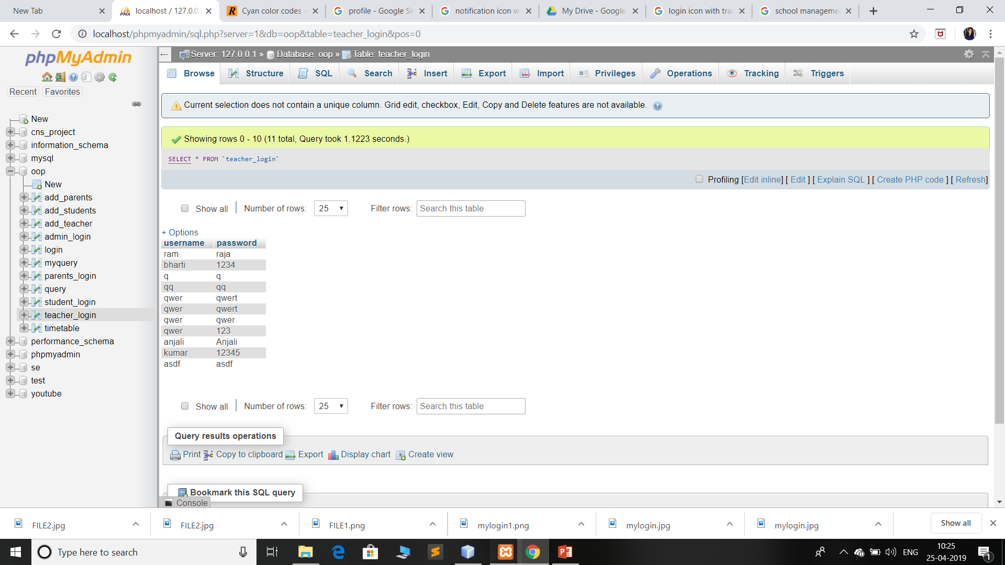
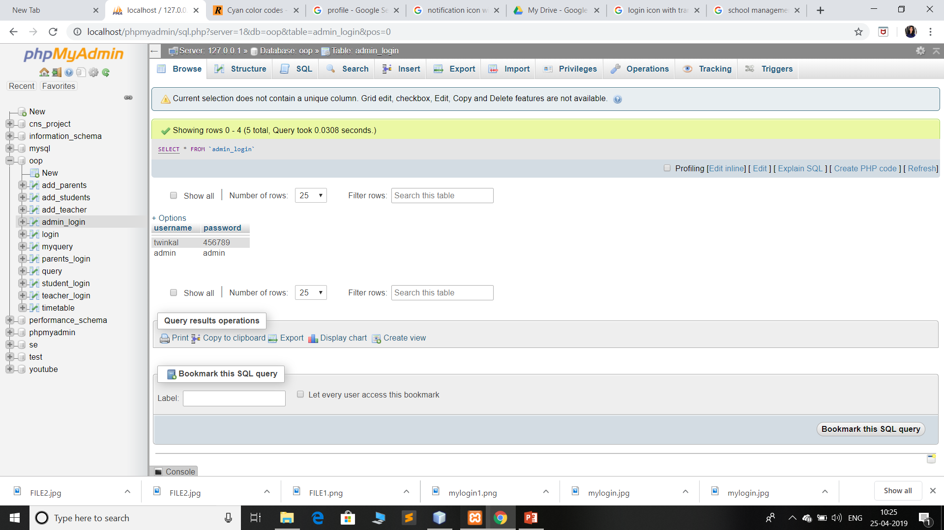

Slide 12

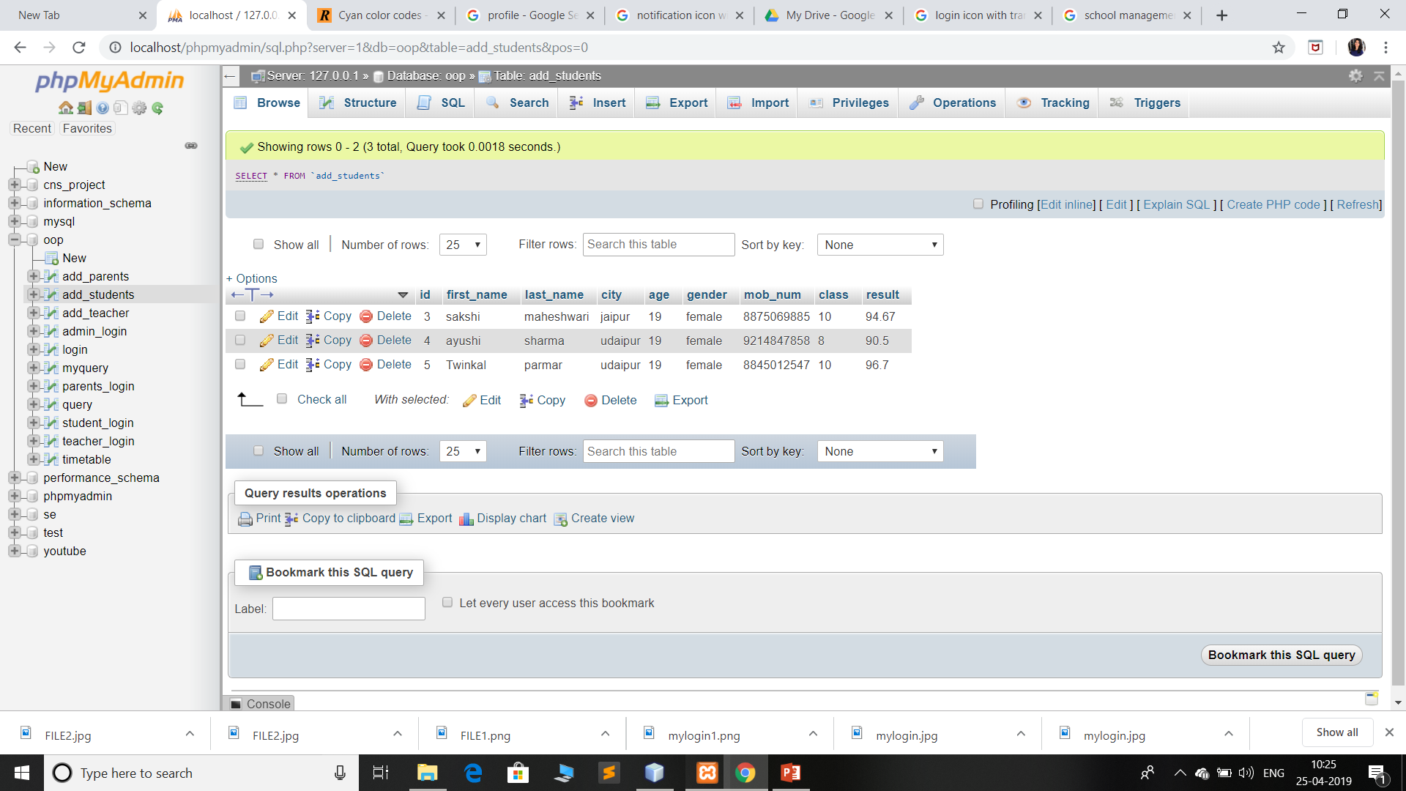

Slide 13
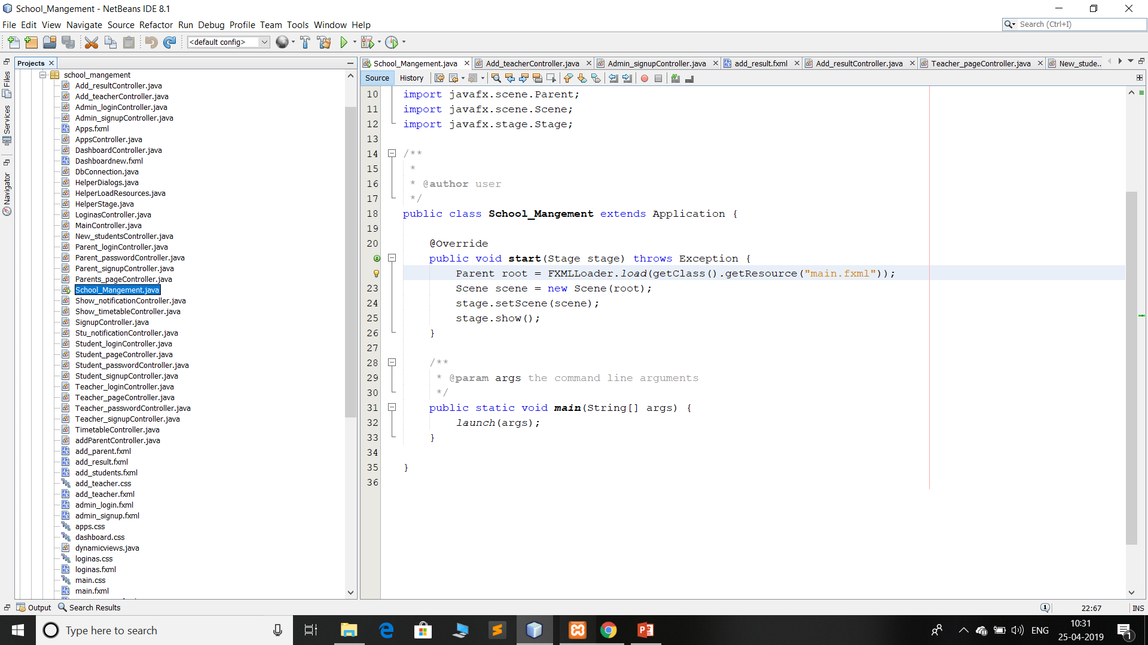
Netbeans Files

Slide 14

DATABASES

Slide 15
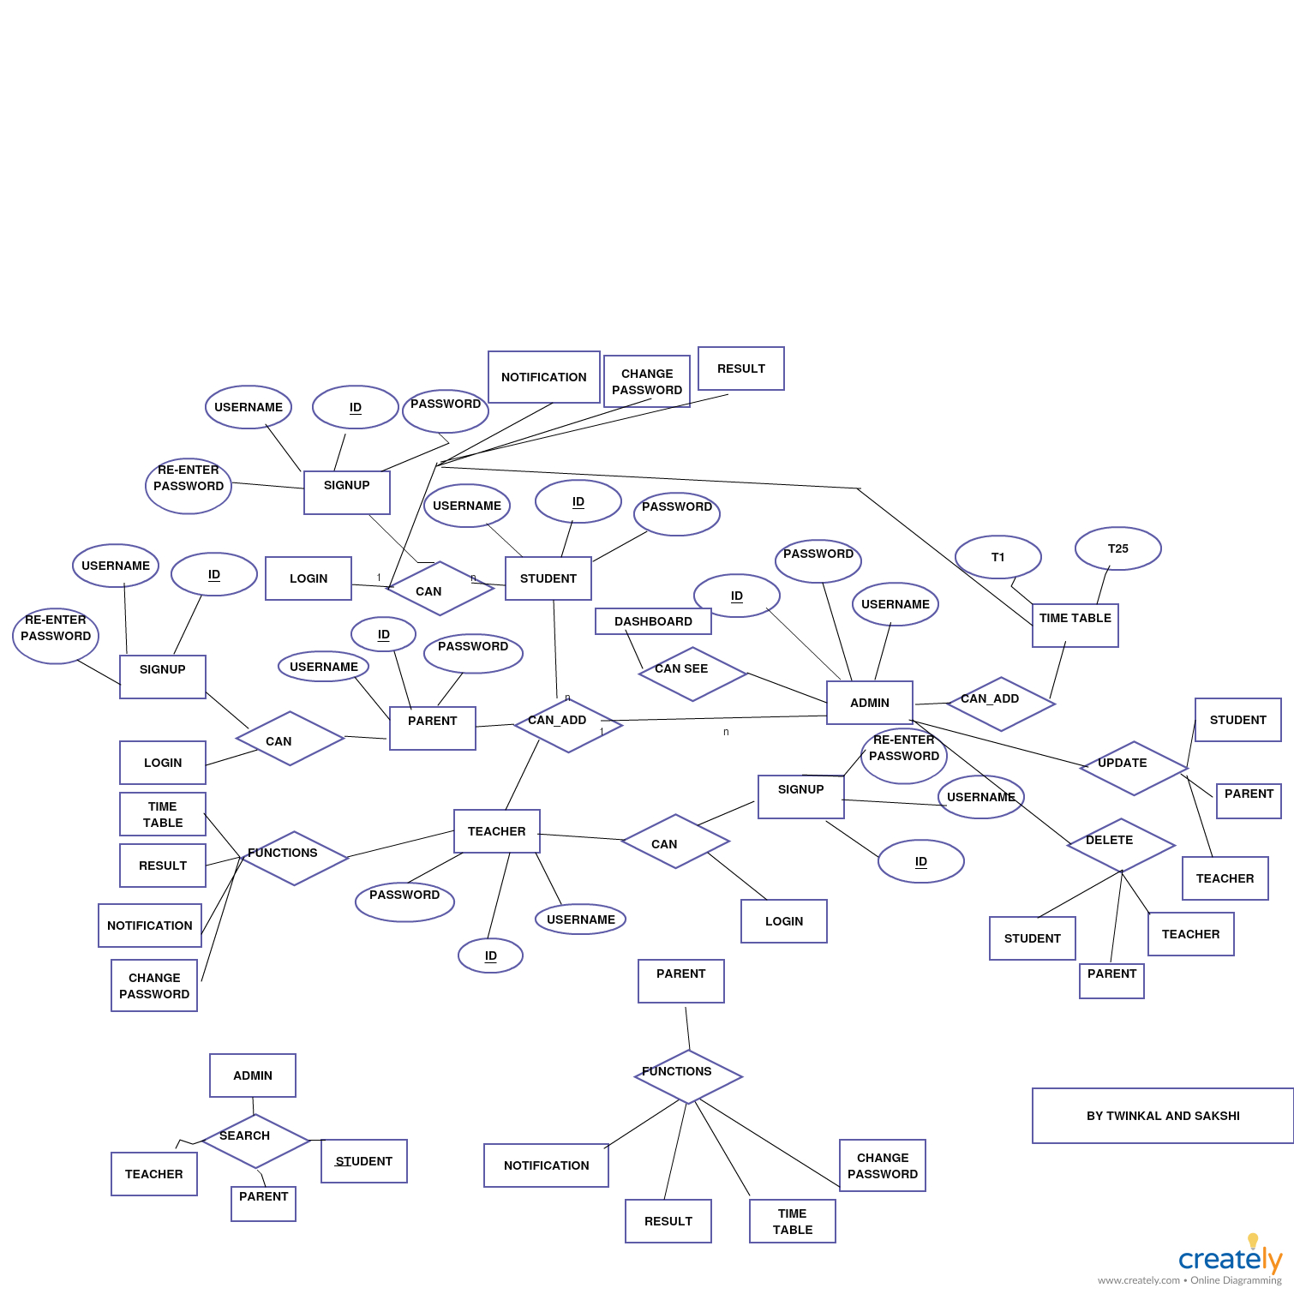
ER DIAGRAM

Slide 16

Thank you
Submitted By
SAKSHI MAHESHWARI(2016ucp1617)
TWINKAL PARMAR(2016ucp1700)

